Slide 1

Travel Itinerary Helper
Gal Malka, Ilan Ben Zeev

Slide 2
Fact
More and more Israelis goes abroad
*By the Israel Central Bureau of Statistics

Slide 3

The Problem
Arrival times from place to place
Time to plan
Make priority
?
?
?
?
Find information
Decide where to go
Lots of information to process

Slide 4




Current Market
Google Maps
Trip Advisor
Roadtrippers
Find locations and build non optimality routes
Find attractions information and rank by users without the possibility to build route
Build shortest route from several places without places ranking, priority consideration and limited to the US only

Slide 5

Our Goal
View attractions with their information and ranking
Find or locate places and attractions you want to visit
Routes details
Optimize Route
Combine all features into one app
Priority list
Time schedule
Add new features

Slide 6
The Algorithm
Travel
App calculation
The app will build a route based on your preferences
Make schedules
Choose the amount of time you want to spend for each place
Make a priority
Decide which places you would like to visit more than others
Locate or Search for places
add your places nor get recommendations for nearby attractions

Slide 7
Project Complexity
1. Best route definition
Time shortest
Distance shortest
2. Route factors
Transportation type
Opening hours
Unexpected delays
3. Data
Work with APIs
Missing details
4. Designing the algorithm
No existing algorithm
Time complexity

Slide 8





Tools
React Native
MongoDB
GitHub
MongoDB
Google Places API
VSCode
GitHub

Slide 9
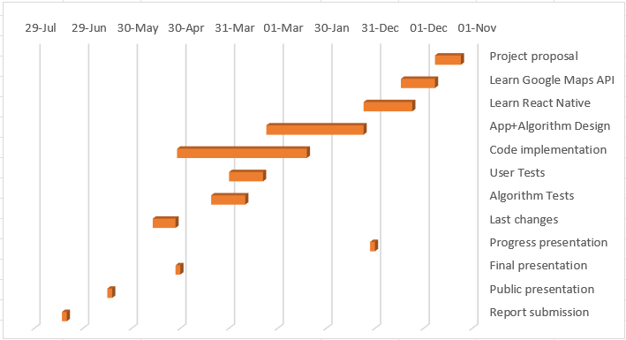
Gantt

Slide 10
THANK YOU

